Slide 1


Predicting House Prices Based on Various Factors
By: Jared Mcleod
Professor Iranitalab

Slide 2
Importance
Housing prices are ridiculously high right now
Interest rates are extremely high as well
Predicting housing market is crucial for all
Overestimating and underestimating causes significant issues
Aims to develop a model that aids in when to buy and sell property

Slide 3
Dataset
From Kaggle
House Prices - Advanced Regression Techniques
Looks at homes only in Iowa
Varies from state to state
dataset includes over 70 features related homes in Ames, Iowa
size of the house
number of bedrooms
year built
quality of materials
neighborhood information

Slide 4
Analysis Methods
Data Preprocessing: Cleaning the data, handling missing values, and feature engineering.
Exploratory Data Analysis (EDA): Understanding the distribution of the data, identifying correlations between variables, and visualizing key features.
Regression Modeling: Using algorithms like Linear Regression, Decision Trees, and Random Forest to predict house prices.
Exploratory Data Analysis (EDA): Understanding the distribution of the data, identifying correlations between variables, and visualizing key features.
Model Evaluation: Evaluating model performance using metrics such as Mean Absolute Error (MAE) and Root Mean Squared Error (RMSE).

Slide 5
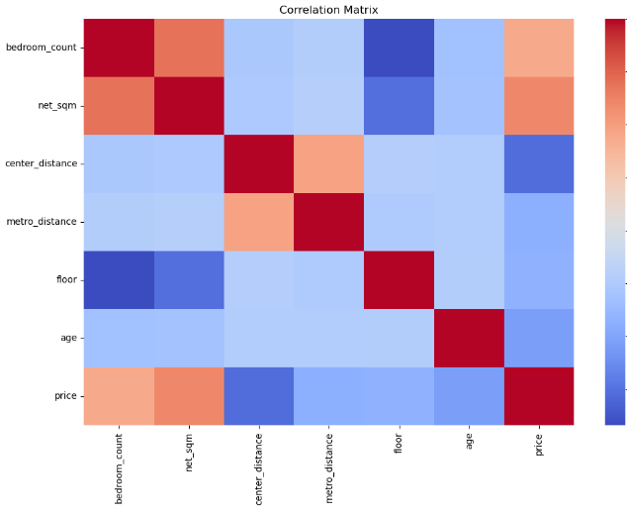
HeatMap

Slide 6
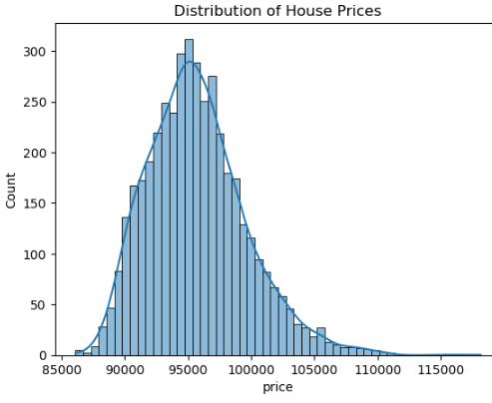
Distribution Graph

Slide 7
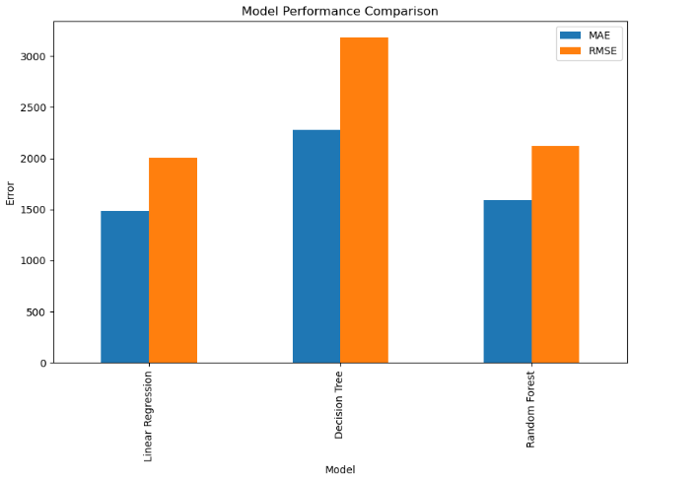
Bar Graph

Slide 8


Questions?

